Slide 2
Topic – Introduction to Spark
ITECH2302 Big Data Management

Slide 3
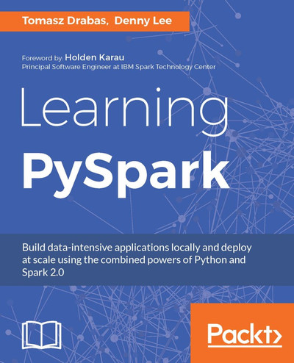
Chapter 1. Understanding Spark
https://learning.oreilly.com/library/view/learning-pyspark/9781786463708/ch01.html

Slide 4
Introduction to Spark
Many big-data applications demand better performance than is possible with disk-intensive operations.
In particular, fast streaming applications that require either real-time or near-real-time processing won’t work in a disk-based architecture.
Apache Spark is an open-source unified analytics engine for large-scale data processing.
Spark provides an interface for programming entire clusters with implicit data parallelism and fault tolerance.
Notes:
4

Slide 5
Introduction to Spark
Architecture and components
Resilient distributed datasets(RDD).
SQL, DataFrames, and datasets:
Streaming (DStreams):
Machine learning library(MLlib).
GraphX:
Notes:
Spark consists of the following components:
Resilient distributed datasets. This is an API that provides the functionality to perform operations in a distributed environment
SQL, DataFrames, and datasets: this module contains interfaces to operate structured data
Streaming (DStreams): Extension for the distributed processing of live data streams
Machine learning library(MLlib). The collection of machine learning algorithms and utilities
GraphX: extensions that integrate graph-parallel computation
5

Slide 6
Introduction to Spark
Spark deployment modes
Spark programs require a connection to a Spark cluster, in order to perform any computation
Spark allows users to load data into the memory storage of the cluster
Spark Context is the main entry point for Spark application.
Node 1
Spark program
Spark context
Node 2
Node 3
Notes:
Spark Context is the main entry point for Spark application, and it represents a connection to the cluster that can be used to create RDDs and perform distributed computation:
6

Slide 7
Introduction to Spark
Architecture and components
Spark uses an in-memory architecture
that has bee used to sort of data faster than Hadoop MapReduce on .
Spark’s significantly better performance on batch-processing tasks is leading many companies to replace Hadoop MapReduce with Spark.
Spark can run standalone on
a single computer,
standalone on a cluster or
using various cluster managers and distributed storage systems.
For resource management, Spark runs on Hadoop YARN, Apache Mesos, Amazon EC2 and supports many distributed storage systems.
Notes:
Spark can run standalone on a single computer(typically for learning and testing purposes), standalone on a cluster or using various cluster managers and distributed storage systems. For resource management, Spark runs on Hadoop YARN, Apache Mesos, Amazon EC2 and supports many distributed storage systems.
7

Slide 8
Introduction to Spark
Architecture and components
The core of Spark are resilient distributed datasets(RDDs).
RDDs eliminate this overhead by remaining in memory , using disk only if the data will not fit in memory, and by not replicating data.
Spark handles fault tolerance by remembering the steps used to create each RDD, so it can rebuild a given RDD if a cluster node fails.
Notes:
At the core of Spark are resilient distributed datasets(RDDs). In addition to reading data from disk and writing data to disk, Hadoop uses replication for fault tolerance, which adds even more disk-based overhead. RDDs eliminate this overhead by remaining in memory , using disk only if the data will not fit in memory, and by not replicating data. Spark handles fault tolerance by remembering the steps used to create each RDD, so it can rebuild a given RDD if a cluster node fails.
8

Slide 9
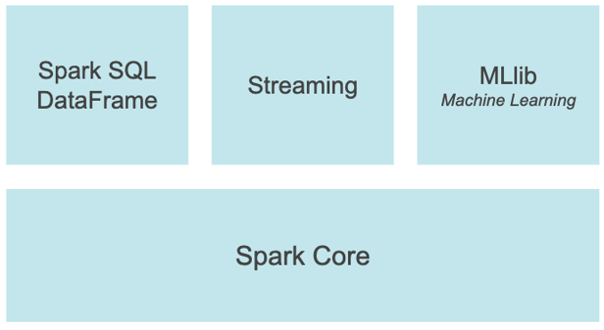
PySpark is an interface for Apache Spark in Python. It not only allows you to write Spark applications using Python APIs, but also provides the PySpark shell for interactively analyzing your data in a distributed environment. PySpark supports most of Spark’s features such as Spark SQL, DataFrame, Streaming, MLlib (Machine Learning) and Spark Core.
Notes:
https://spark.apache.org/docs/latest/api/python/#:~:text=PySpark%20is%20an%20interface%20for,data%20in%20a%20distributed%20environment.

Slide 10
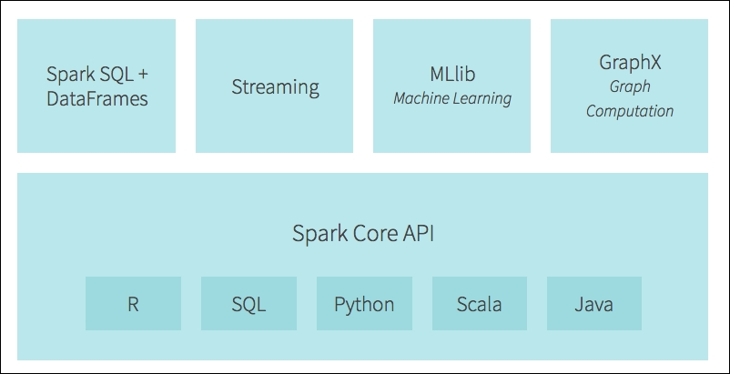

Slide 11
Spark SQL and DataFrame
Spark SQL is a Spark module for structured data processing. It provides a programming abstraction called DataFrame and can also act as distributed SQL query engine.

Slide 12
pandas API on Spark
pandas API on Spark allows you to scale your pandas workload out. With this package, you can:
Be immediately productive with Spark, with no learning curve, if you are already familiar with pandas.
Have a single codebase that works both with pandas (tests, smaller datasets) and with Spark (distributed datasets).
Switch to pandas API and PySpark API contexts easily without any overhead.

Slide 13
Streaming
Running on top of Spark, the streaming feature in Apache Spark enables powerful interactive and analytical applications across both streaming and historical data, while inheriting Spark’s ease of use and fault tolerance characteristics.

Slide 14
MLlib
Built on top of Spark, MLlib is a scalable machine learning library that provides a uniform set of high-level APIs that help users create and tune practical machine learning pipelines.

Slide 15
Spark Core
Spark Core is the underlying general execution engine for the Spark platform that all other functionality is built on top of. It provides an RDD (Resilient Distributed Dataset) and in-memory computing capabilities.

Slide 16
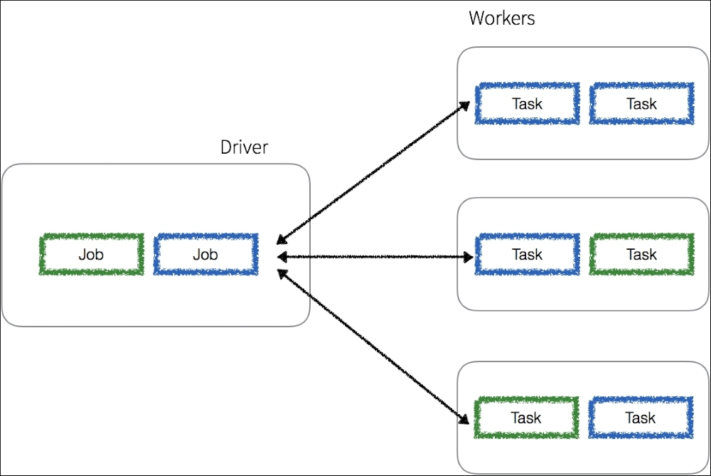
Driver process , Scheduling
Any Spark application spins off a single driver process (that can contain multiple jobs) on the master node that then directs executor processes (that contain multiple tasks) distributed to a number of worker nodes
Notes:
The driver process determines the number and the composition of the task processes directed to the executor nodes based on the graph generated for the given job. Note, that any worker node can execute tasks from a number of different jobs.

Slide 17
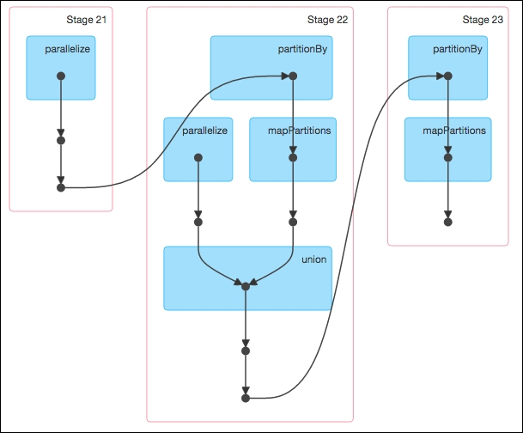
DAG
A Spark job is associated with a chain of object dependencies organized in a direct acyclic graph (DAG)
Given this, Spark can optimize the scheduling (for example, determine the number of tasks and workers required) and execution of these tasks

Slide 18
Transformations Actions
RDDs have two sets of parallel operations: transformations (which return pointers to new RDDs) and actions (which return values to the driver after running a computation); we will cover these in greater detail in later chapters.

Slide 19
Programing languages
Spark supports the following programing languages:
Scala
Java
Python
R
SQL
Notes:
At present, spark supports many languages: Scala, python, Java, R. Developers can decide which language is used to develop spark programs according to the application
19

Slide 20
Data processing in Spark
RDD
RDD data has no schema defined
Spark DataFrame
Schema must be defined when spark is established
Spark SQL
we need to first create DataFrame
Notes:
There are three ways to process spark data，
RDD
RDD data has no schema defined (that is, every field name and data type are not defined). We need to use the concept of MapReduce to process data.
Spark DataFrame
Schema must be defined when spark is established. We need to define each field name and data type.
Spark SQL
In this case, we need to first create DataFrame, and then use Spark SQL temp table.
Spark distributes the operations you specify (e.g., in Python) to the cluster’s nodes for parallel execution. Spark streaming enables you to process data as it’s received. Spark DataFrames, which are similar to pandas DataFrames, enable you to view RDDs as a collection of named columns. You can use Spark DataFrames with Spark SQL to perform queries on distributed data. Spark also includes Spark MLlib( Spark Machine Learning Library), which enables you to perform machine-learning algorithms.
20

Slide 21
Resilient distributed datasets(RDDs)
RDD is an abstraction that hides most of the complexity behind distributed computation, such as consistency of state and recovery from node failures.
RDDs represent collection of elements that are distributed across different nodes in a cluster.
Node 1
Data subset 1
Node 2
Data subset 2
Node 3
Data subset 3
Notes:
Spark’s resilient distributed dataset is an abstraction that hides most of the complexity behind distributed computation, such as consistency of state and recovery from node failures. RDDs represent collection of elements that are distributed across different nodes in a cluster.
The consistency of state has proven to be a difficult problem to solve in distributed systems. Spark handles this problem by introducing the concept of shared variables. These types of variables can be used safely in parallel operations. The above diagram depicts a Spark cluster.
21

Slide 22
Resilient distributed datasets(RDDs)
Resilient distributed datasets(RDDs)
During spark performing operation, the data generated in operating process is temporarily stored in memory
Therefore, the performing operation speed can be accelerated，
Performing operation
Write in memory
Performing operation
Write in memory
Performing operation
Notes:
22

Slide 23
Resilient Distributed Dataset
Apache Spark is built around a distributed collection of immutable Java Virtual Machine (JVM) objects called Resilient Distributed Datasets (RDDs for short). As we are working with Python, it is important to note that the Python data is stored within these JVM objects.
These objects allow any job to perform calculations very quickly. RDDs are calculated against, cached, and stored in-memory: a scheme that results in orders of magnitude faster computations compared to other traditional distributed frameworks like Apache Hadoop.

Slide 24
Resilient Distributed Dataset
At the same time, RDDs expose some coarse-grained transformations (such as map(...), reduce(...), and filter(...) keeping the flexibility and extensibility of the Hadoop platform to perform a wide variety of calculations.
RDDs apply and log transformations to the data in parallel, resulting in both increased speed and fault-tolerance. By registering the transformations, RDDs provide data lineage - a form of an ancestry tree for each intermediate step in the form of a graph.
This, in effect, guards the RDDs against data loss - if a partition of an RDD is lost it still has enough information to recreate that partition instead of simply depending on replication.

Slide 25
DataFrames
DataFrames, like RDDs, are immutable collections of data distributed among the nodes in a cluster. However, unlike RDDs, in DataFrames data is organized into named columns.

Slide 26
Datasets
Introduced in Spark 1.6, the goal of Spark Datasets is to provide an API that allows users to easily express transformations on domain objects, while also providing the performance and benefits of the robust Spark SQL execution engine. Unfortunately, at the time of writing this book Datasets are only available in Scala or Java. When they are available in PySpark we will cover them in future editions.

Slide 27
Catalyst Optimizer
Spark SQL is one of the most technically involved components of Apache Spark as it powers both SQL queries and the DataFrame API. At the core of Spark SQL is the Catalyst Optimizer.
The optimizer is based on functional programming constructs and was designed with two purposes in mind: To ease the addition of new optimization techniques and features to Spark SQL and to allow external developers to extend the optimizer (for example, adding data source specific rules, support for new data types, and so on)

Slide 28
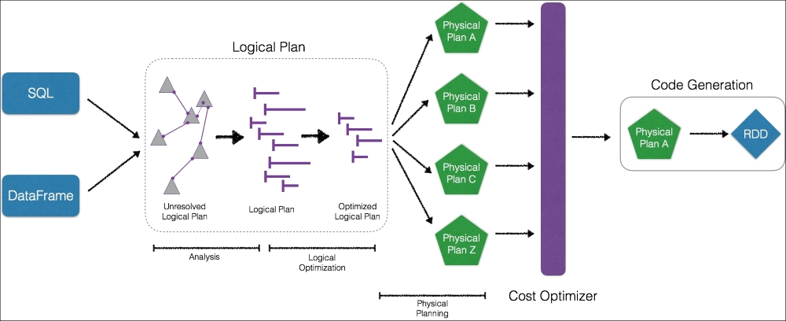

Slide 29
Project Tungsten
Tungsten is the codename for an umbrella project of Apache Spark's execution engine. The project focuses on improving the Spark algorithms so they use memory and CPU more efficiently, pushing the performance of modern hardware closer to its limits.
The efforts of this project focus, among others, on:
Managing memory explicitly so the overhead of JVM's object model and garbage collection are eliminated
Designing algorithms and data structures that exploit the memory hierarchy
Generating code in runtime so the applications can exploit modern compliers and optimize for CPUs
Eliminating virtual function dispatches so that multiple CPU calls are reduced
Utilizing low-level programming (for example, loading immediate data to CPU registers) speed up the memory access and optimizing Spark's engine to efficiently compile and execute simple loops
Notes:
Apache Spark as a Compiler: Joining a Billion Rows per Second on a Laptop (https://databricks.com/blog/2016/05/23/apache-spark-as-a-compiler-joining-a-billion-rows-per-second-on-a-laptop.html)

Slide 30
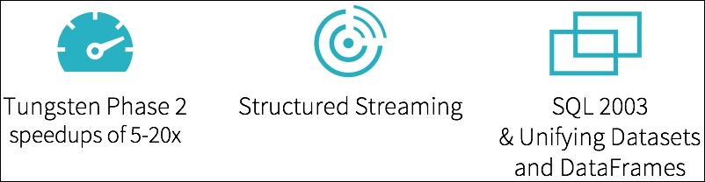
Spark 2.0 architecture
The introduction of Apache Spark 2.0 is the recent major release of the Apache Spark project based on the key learnings from the last two years of development of the platform:

Slide 31
Unifying Datasets and DataFrames
Datasets were introduced in 2015 as part of the Apache Spark 1.6 release. The goal for datasets was to provide a type-safe, programming interface. This allowed developers to work with semi-structured data (like JSON or key-value pairs) with compile time type safety (that is, production applications can be checked for errors before they run). Part of the reason why Python does not implement a Dataset API is because Python is not a type-safe language.
Just as important, the Datasets API contain high-level domain specific language operations such as sum(), avg(), join(), and group(). This latter trait means that you have the flexibility of traditional Spark RDDs but the code is also easier to express, read, and write. Similar to DataFrames, Datasets can take advantage of Spark's catalyst optimizer by exposing expressions and data fields to a query planner and making use of Tungsten's fast in-memory encoding.

Slide 32
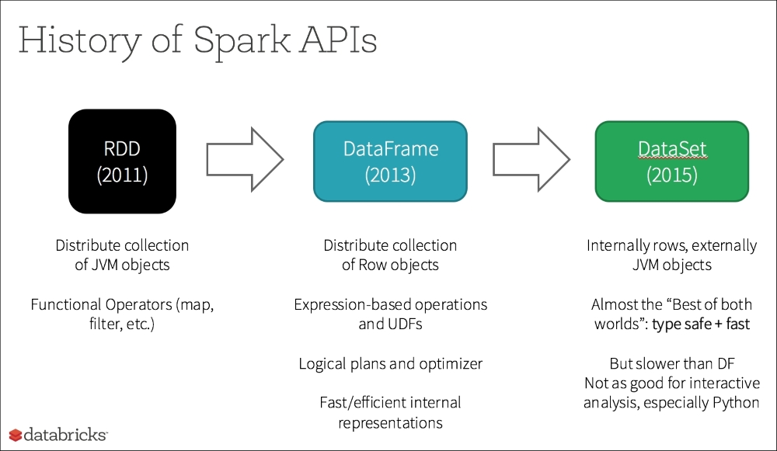
Notes:
The history of the Spark APIs is denoted in the following diagram noting the progression from RDD to DataFrame to Dataset:

Slide 33
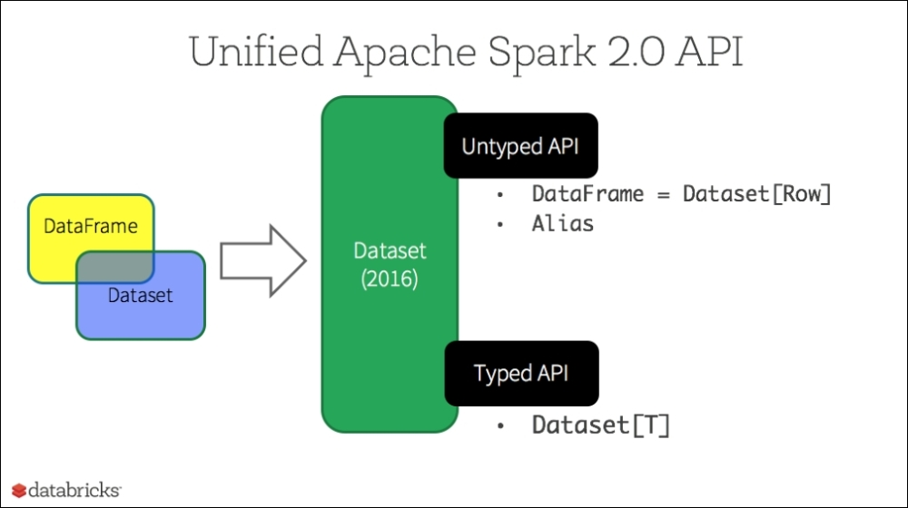
Notes:
The unification of the DataFrame and Dataset APIs has the potential of creating breaking changes to backwards compatibility. This was one of the main reasons Apache Spark 2.0 was a major release (as opposed to a 1.x minor release which would have minimized any breaking changes). As you can see from the following diagram, DataFrame and Dataset both belong to the new Dataset API introduced as part of Apache Spark 2.0:

Slide 34
Tungsten phase 2
Improvements in price per performance in RAM memory, disk, and (to an extent) network interfaces, but the price per performance advancements for CPUs were not the same.
Though hardware manufacturers could put more cores in each socket (i.e. improve performance through parallelization), there were no significant improvements in the actual core speed.
Project Tungsten was introduced in 2015 to make significant changes to the Spark engine with the focus on improving performance. The first phase of these improvements focused on the following facets:
Memory Management and Binary Processing: Leveraging application semantics to manage memory explicitly and eliminate the overhead of the JVM object model and garbage collection
Cache-aware computation: Algorithms and data structures to exploit memory hierarchy
Code generation: Using code generation to exploit modern compilers and CPUs

Slide 35
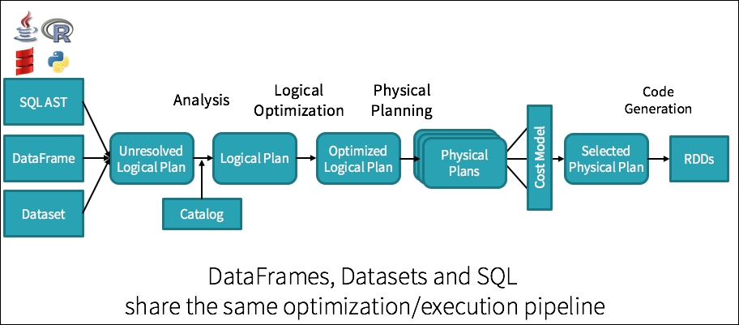
Updated Catalyst engine to denote the inclusion of Datasets.
Code Generation is used against the selected physical plans to generate the underlying RDDs
Notes:
Updated Catalyst engine to denote the inclusion of Datasets.
Code Generation is used against the selected physical plans to generate the underlying RDDs

Slide 36
Structured Streaming
As quoted by Reynold Xin during Spark Summit East 2016:
"The simplest way to perform streaming analytics is not having to reason about streaming.“
This is the underlying foundation for building Structured Streaming. While streaming is powerful, one of the key issues is that streaming can be difficult to build and maintain. While companies such as Uber, Netflix, and Pinterest have Spark Streaming applications running in production, they also have dedicated teams to ensure the systems are highly available.

Slide 37
Summary
What is Apache Spark
Spark Jobs and APIs.
Resilient Distributed Datasets (RDDs), DataFrames, and Datasets
DataFrames can provide faster query performance in Apache Spark
Spark SQL Engine's Catalyst Optimizer
Project Tungsten.
Spark 2.0 architecture
Tungsten Phase 2
Structured Streaming
Unifying DataFrames and Datasets.

Slide 38
End of the lecture
Questions, comments
Notes:
38

